Slide 1
Punctuations, Stasis & Gradualism

Slide 2
Presentation rubric
1. Introduce sufficient biological background on research topic
2. Presents a coherent research question with explicit connection made to actual research conducted
3. Methodology explained in detail. Relevant assumptions identified/justified/defended. (This is expected to be more extensive for our class than typical presentations.
4. Data sources and structure described sufficiently.
5. Results correctly interpreted in terms of biological question. (Units, parameters, in understandable, biological terms!)
6. Appropriate model caveats and violated assumptions identified, suggestions for methods that may answer the question better.
Additional components:
1. Well organized and clearly presented (limited amount of text)
2. 12 minutes with 3 minutes for questions
3. Good audience interaction, clear and concise delivery

Slide 3
Take 5 minutes to write down answers to the following questions:
1. What is the pattern of Punctuated Equilibrium (PE)?
2. What process generates the pattern? Be as specific as you can about the exact mechanism.
3. What are the implications of PE for our understanding of macroevolution?
4. Do you think it is controversial? Why or why not?

Slide 4
Is evolution faster in small or large populations?

Slide 5
What is the definition of stasis?

Slide 6


Slide 7
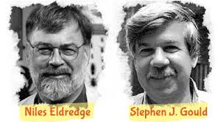
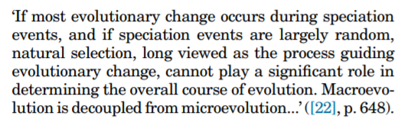
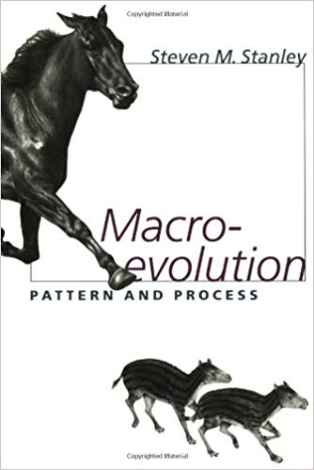

Slide 8
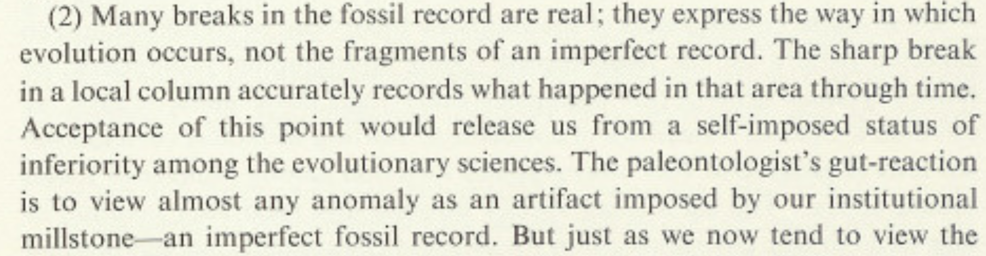
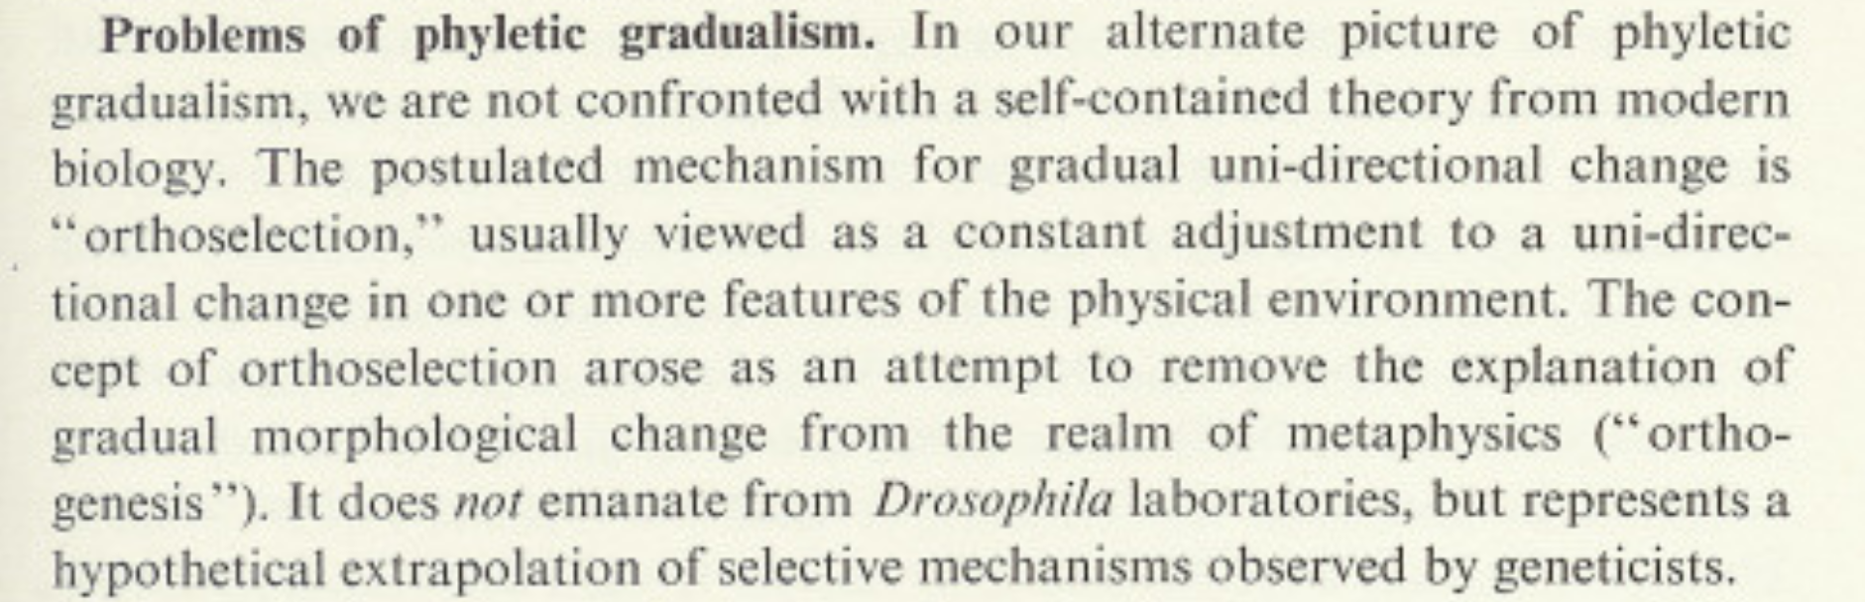

Slide 9
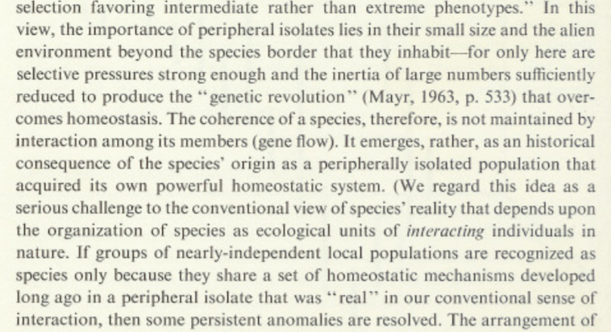

Slide 10
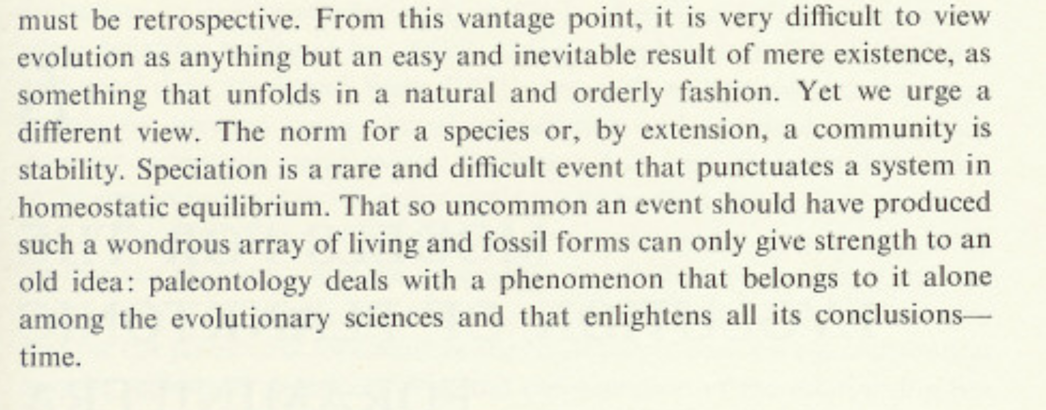

Slide 11
Testable in the fossil record?

Slide 12
Testable with PCMs?

Slide 13
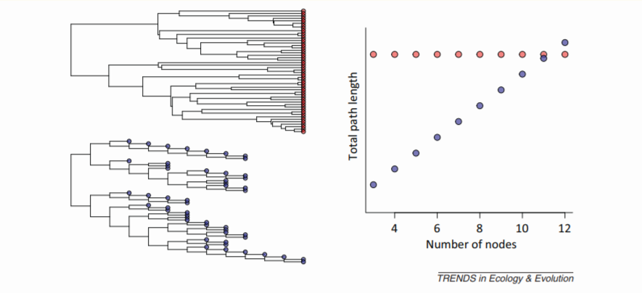

Slide 14
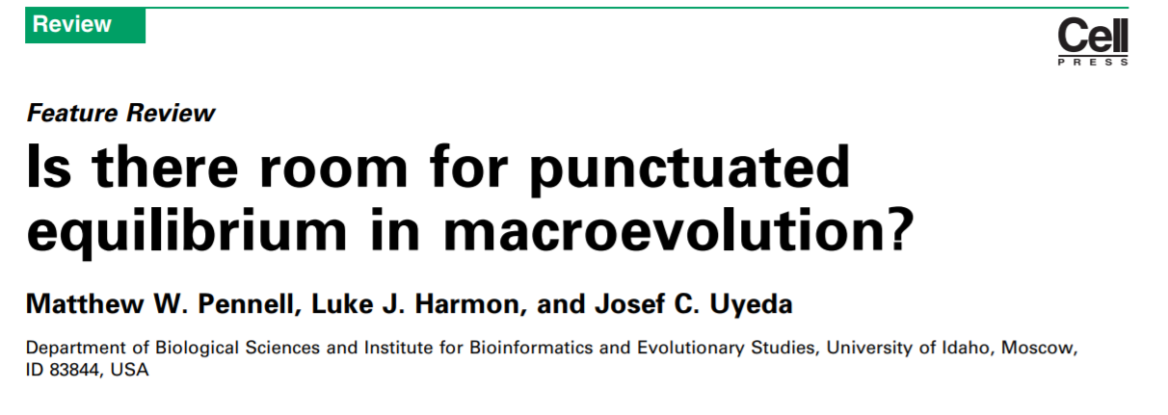
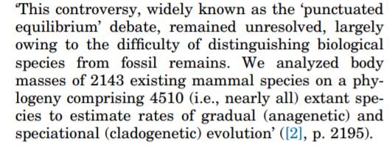
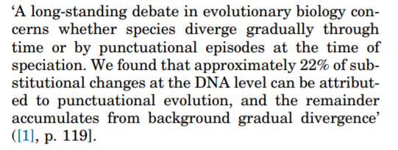
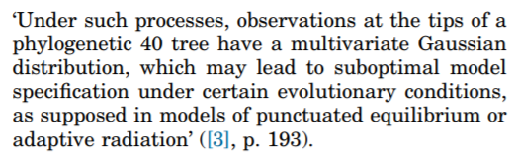
Our argument...

Slide 15
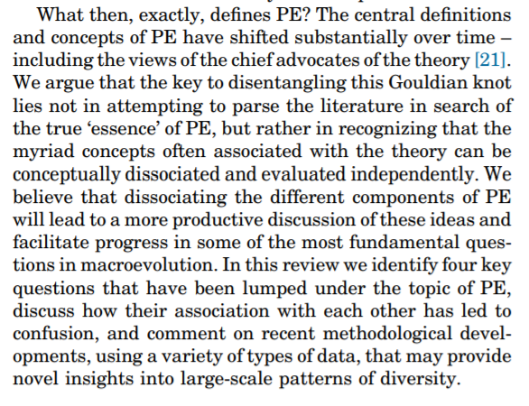
Our argument...

Slide 16
Our argument... “PE” is 4 distinct questions
1. What is the relative importance of gradualistic versus pulsed evolution?
2. What is the role of speciational events (cladogenesis) versus within lineage evolution (anagenesis) in generating trait divergence?
3. When change is cladogenetic, are these changes adaptive or driven by neutral processes?
4. How important is higher level selection (species selection) in shaping patterns of diversity?

Slide 17
The other side of the coin...Stasis
“Stasis is data”
Microevolutionary theory can explain punctuations, but can it explain stasis?

